Slide 1
JAVA PROGRAMMING
Chap 1 : Java Fundamentals

Slide 2
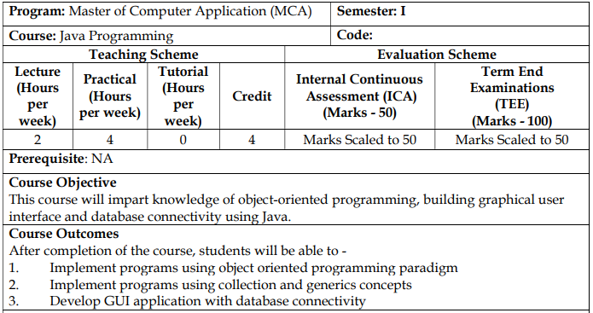

Slide 3
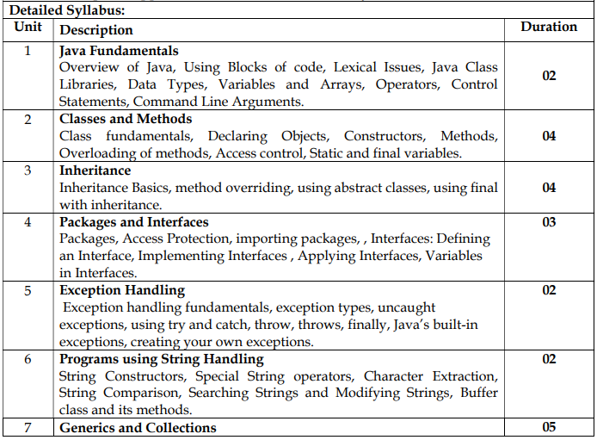

Slide 4
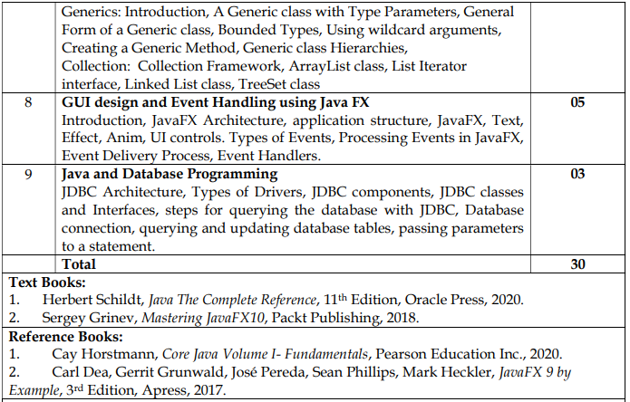

Slide 5
Java is a programming language and a platform.
Java is a high level, robust, object-oriented and secure programming language.
Java was developed by Sun Microsystems (which is now the subsidiary of Oracle) in the year 1995.
James Gosling is known as the father of Java.
Before Java, its name was Oak. Since Oak was already a registered company, so James Gosling and his team changed the name from Oak to Java.

Slide 6
There are mainly 4 types of applications that can be created using Java programming:
1) Standalone Application : Also known as desktop applications or window-based applications are traditional software that we need to install on every machine. Examples of standalone application are Media player, antivirus, etc. AWT and Swing are used in Java for creating standalone applications.
2) Web Application : An application that runs on the server side and creates a dynamic page is called a web application. Currently, Servlet, JSP, Struts, Spring, Hibernate, JSF, etc. technologies are used for creating web applications in Java.
3) Enterprise Application : An application that is distributed in nature, such as banking applications, etc. is called an enterprise application. It has advantages like high-level security, load balancing, and clustering. In Java, EJB is used for creating enterprise applications.
4) Mobile Application : An application which is created for mobile devices is called a mobile application. Currently, Android and Java ME are used for creating mobile applications.

Slide 7
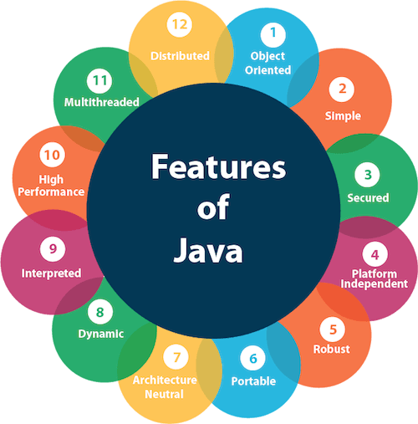
Features of Java
Simple - (No pointers, no operator overloading, no garbage collection, no multiple inheritance)
Object-Oriented
Portable - (bytecode)
Platform independent - (bytecode)
Secured - (no explicit pointer)
Robust - (strong MM Mgmt, Exception Handling, Auto Garbage Collection, no pointers)
Architecture neutral - (bytecode, fixed size of primitive datatypes)
Interpreted
High Performance
Multithreaded
Distributed - (helps to create distributed applns using RMI & EJB)
Dynamic - (uses JIT)
Garbage Collected

Slide 8
Basic concepts of OOPs are:
Object
Class
Inheritance
Polymorphism
Abstraction
Encapsulation

Slide 9
C++ | Java
It is object oriented but not purely. That is a program can be written in C++ without using classes and objects. | It is purely object oriented that is no program can be written without classes and objects.
C++ is platform dependent | Java is platform independent
C++ supports the goto statement. | Java doesn’t support the goto statement.
C++ supports pointers. This makes program system dependent. | Java doesn’t support pointers to avoid platform dependency.
C++ supports multiple and hybrid inheritance | Java does not support multiple and hybrid inheritance. A slight implementation of the same can be done using a special feature called as Interface.
Supports operator overloading | Does not allow operator overloading
Supports 3 access specifiers : public, protected and private | Supports 5 access specifiers : public, protected, private, default and private protected
Destructors are used in C++ | Java is garbage collected that is the objects are automatically destroyed once their use is over
C++ doesn’t have exception handling | Java has exception handling
Doesn’t support multithreading | Supports multithreading

Slide 10
C++ | Java
C++ uses compiler only. C++ is compiled and run using the compiler which converts source code into machine code so, C++ is platform dependent. | Java uses both compiler and interpreter. Java source code is converted into bytecode at compilation time. The interpreter executes this bytecode at runtime and produces output. Java is interpreted that is why it is platform-independent.
C++ supports structures and unions. | Java doesn't support structures and unions
C++ doesn't support documentation comments. | Java supports documentation comment (/** ... */) to create documentation for java source code.
Has header files | uses the import keyword to include different classes and methods
mainly used for system programming. | mainly used for application programming

Slide 11
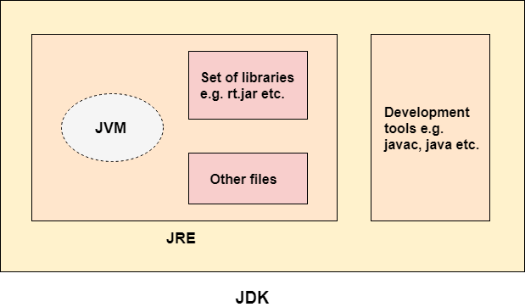
Java Development Kit (JDK)
JDK is an acronym for Java Development Kit.
The Java Development Kit (JDK) is a software development environment which is used to develop Java applications and applets.
It physically exists. It contains JRE + development tools.
The JDK contains a private Java Virtual Machine (JVM) and a few other resources such as an interpreter/loader (java), a compiler (javac), an archiver (jar), a documentation generator (Javadoc), etc. to complete the development of a Java Application.

Slide 12
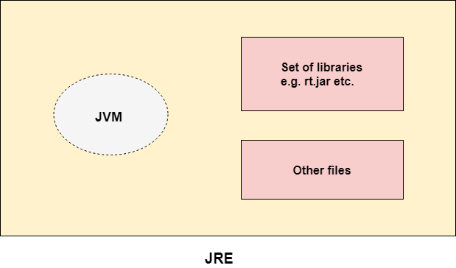
Java Runtime Environment (JRE)
JRE is an acronym for Java Runtime Environment.
It is also written as Java RTE.
The Java Runtime Environment is a set of software tools which are used for developing Java applications.
It is used to provide the runtime environment.
It is the implementation of JVM.
It physically exists.
It contains a set of libraries + other files that JVM uses at runtime.
The implementation of JVM is also actively released by other companies besides Sun Micro Systems.

Slide 13
Java Virtual Machine (JVM)
JVM (Java Virtual Machine) is an abstract machine. It is a specification that provides runtime environment in which java bytecode can be executed.
JVM is an interpreter. It is the main component of Java that makes java platform independent.
It is because the bytecode file can be taken onto any system and the JVM residing in that system will interpret and translate the byte code into machine readable code.
The JVM performs following operation:
Loads code
Verifies code
Executes code
Provides runtime environment

Slide 14
Tokens of Java
Character Set
Keywords
Identifiers
Constants & variables
Datatypes
operators

Slide 15
Character Set
Alphabets: Both lowercase (a, b, c, d, e, etc.) and uppercase (A, B, C, D, E, etc.).
Digits: 0, 1, 2, 3, 4, 5, 6, 7, 8, 9.
Special symbols: _, (, ), {, }, [, ], +, -, *, /, %, !, &, |, ~, ^, <, =, >, $, #, ?, Comma (,), Dot (.), Colon (:), Semi-colon (;), Single quote (‘), Double quote (“), Back slash (\).
White space: Space, Tab, New line.

Slide 16
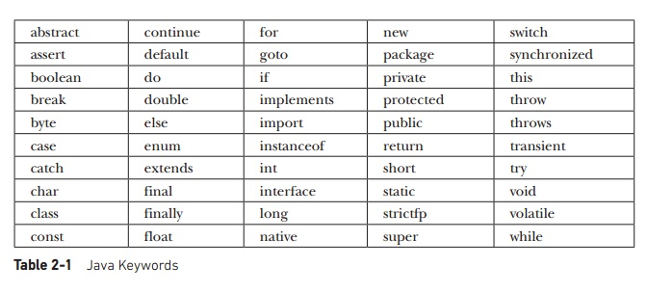
Keywords
There are 50 keywords currently defined in the Java language.
These keywords, combined with the syntax of the operators and separators, form the foundation of the Java language.
These keywords cannot be used as identifiers.
Thus, they cannot be used as names for a variable, class, or method.
In addition to the keywords, Java reserves the following: true, false, and null. These are values defined by Java. You may not use these words for the names of variables, classes, and so on.

Slide 17
Identifiers
Identifiers are used to name things, such as classes, variables, and methods.
An identifier may be any descriptive sequence of uppercase and lowercase letters, numbers, or the underscore and dollar-sign characters. (The dollar-sign character is not intended for general use.)
Following rules needs to be followed while creating identifiers
An identifier can consist of Alphabets, digits, and two special symbols _ (underscore) and $ (dollar)
An identifier cannot start with a digit. It has to start with an alphabet or _ or $
No other special symbols apart from _ and $ are allowed. Not even blank spaces.
An identifier cannot be a keyword.
It is case sensitive. That is firstName, FirstName, firstname are three different identifiers.

Slide 18
Identifiers
Exercise : Identify valid and invalid identifiers from the list given below –
simple_interest
char
3friends
_3$friends
Simple interest
#3friends
void
Void
$xyz

Slide 19
Constants and variables
A constant is an entity in programming that is immutable.
In other words, the value that cannot be changed after assigning it.
In java constants can be defined by using the keyword “final” before the datatype.
Constants are used to declare values that remain constant like value of pi.
Eg : final double pi=3.14;
Variables are containers for storing data values.
A variable is assigned with a data type.
A variable is the name of a reserved area allocated in memory.
In other words, it is a name of the memory location.
It is a combination of "vary + able" which means its value can be changed.
eg: int data=50; //Here data is a variable

Slide 20
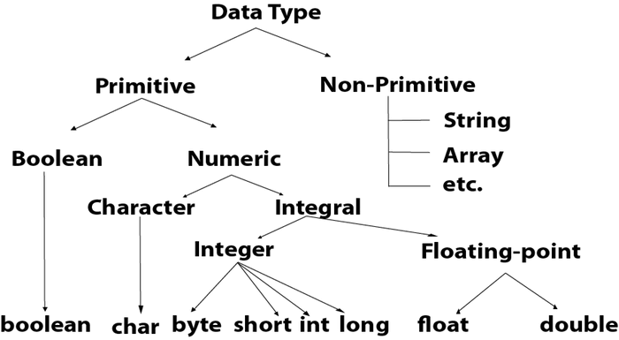
Datatypes
Data types specify the different sizes and values that can be stored in the variable.
There are two types of data types in Java:
Primitive data types: The primitive data types include boolean, char, byte, short, int, long, float and double.
Non-primitive data types: The non-primitive data types include Classes, Interfaces, and Arrays.

Slide 21
Datatypes
Data Type | Default Value | Default size | Range
boolean | false | 1 bit | true or false
char | '\u0000' | 2 byte | '\u0000' (or 0) to '\uffff' (or 65,535 inclusive).
byte | 0 | 1 byte | -128 to 127 (inclusive)
short | 0 | 2 byte | -32,768 to 32,767 (inclusive)
int | 0 | 4 byte | - 2,147,483,648 to 2,147,483,647 (inclusive)
long | 0L | 8 byte | -9,223,372,036,854,775,808 to 9,223,372,036,854,775,807 (inclusive)
float | 0.0f | 4 byte | -3.4e38 to 3.4e38
double | 0.0d | 8 byte | Its value range is unlimited

Slide 22
Operators
There are many types of operators in Java which are given below:
Unary Operator
Arithmetic Operator
Shift Operator
Relational Operator
Bitwise Operator
Logical Operator
Ternary Operator
Assignment Operator

Slide 23
Operators
Operator precedence
Operator Type | Category | Precedence
Unary | postfix | expr++ expr--
 | prefix | ++expr --expr +expr -expr ~ !
Arithmetic | multiplicative | * / %
 | additive | + -
Shift | shift | << >> >>>
Relational | comparison | < > <= >= instanceof
 | equality | == !=
Bitwise | bitwise AND | &
 | bitwise exclusive OR | ^
 | bitwise inclusive OR | |
Logical | logical AND | &&
 | logical OR | ||
Ternary | ternary | ? :
Assignment | assignment | = += -= *= /= %= &= ^= |= <<= >>= >>>=

Slide 24
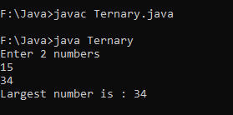
Ternary Operator
The operator that requires three operands is called as Ternary Operator.
Java supports only one ternary operator ? :
Syntax : (condition) ? (Value if true) : (value if false)
import java.util.*;
class Ternary{
public static void main(String args[]){
int a, b, large;
Scanner sc=new Scanner(System.in);
System.out.println("Enter 2 numbers");
a=sc.nextInt();
b=sc.nextInt();
large=(a>b)?a:b;
System.out.println("Largest number is : "+large);
} }

Slide 25
Comments
Single line Comments - // comments
Multi line comments - /* comments */
Documentation comments - /** comments */

Slide 26
Input/Output in Java
Output in Java
System.out.println(“Hello”);
System – class of Java.lang package
out – variable of class System corresponding to the std o/p device i.e. monitor
println()/print() – static methods for displaying content
Input in Java
BufferedReader – readLine()
Scanner – nextInt(), nextLong(), nextFloat(), nextDouble(), next(), nextLine()

Slide 27
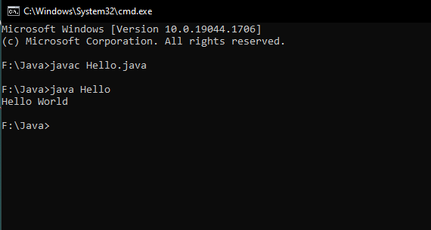
Simple Java Program
class Hello{
public static void main(String args[])
{
System.out.println("Hello World");
}
}
Output :

Slide 28
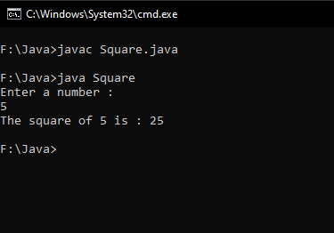
Program for accepting input (Scanner)
import java.util.*;
class Square{
public static void main(String args[])
{
int i, res;
Scanner sc=new Scanner (System.in);
System.out.println(“Enter a number : “);
i=sc.nextInt();
res=i*i;
System.out.println(“The square of “ + i + “ is : “ + res);
}
}

Slide 29
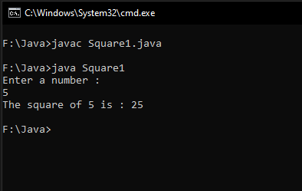
Program for accepting input (BufferedReader)
import java.io.*;
class Square{
public static void main(String args[]) throws IOException
{
int i, res;
BufferedReader br=new BufferedReader (new InputStreamReader(System.in));
String str;
System.out.println(“Enter a number : “);
str=br.readLine();
i=Integer.parseInt(str);
res=i*i;
System.out.println(“The square of “ + i + “ is : “ + res);
}
}

Slide 30
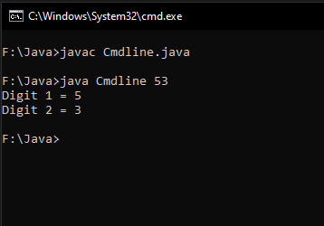
Program for accepting input (command line)
class Cmdline{
public static void main(String args[])
{
int n,d1,d2;
n=Integer.parseInt(args[0]);
d2=n%10;
d1=n/10;System.out.println("Digit 1 = "+d1+"\nDigit 2 = "+d2);
}
}

Slide 31
Typecasting in Java
Type casting is a method or process that converts a data type into another data type in both ways manually and automatically.
The automatic conversion is done by the compiler and manual conversion performed by the programmer
Converting a lower data type into a higher one is called as implicit conversion or casting down.
It is done automatically.
It takes place when:
Both data types must be compatible with each other.
The target type must be larger than the source type.
Eg : typecasting int to long
Converting a higher data type into a lower one is called as explicit conversion or casting up.
It is done manually by the programmer.
If we do not perform casting then the compiler reports a compile-time error.
Eg : typecasting float to byte
Syntax for explicit typecasting –
(target datatype)source datatype variable
Eg : float x;
(byte) x;

Slide 32
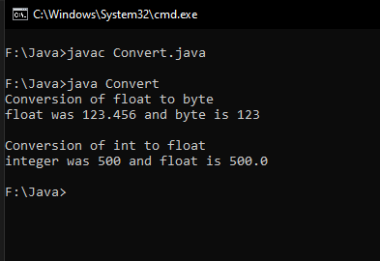
Typecasting in Java
class Convert{
public static void main(String args[])
{
byte b;
int i=500;
float f=123.456f;
System.out.println("Conversion of float to byte");
b=(byte) f; // explicit typecasting
System.out.println("float was "+f+ " and byte is "+b+"\n");
System.out.println("Conversion of int to float");
f=i; // implicit typecasting
System.out.println("integer was "+i+ " and float is "+f);
}
}

Slide 33
Control statements
Control statements are of two types
Conditional statements – if-else, switch case
Iterative statements – for, while, do while

Slide 34
Conditional Statements
If-Else statements
Switch statements
import java.util.*;
class PositiveNegativeExample {
public static void main(String[] args) {
int n;
Scanner sc=new Scanner (System.in);
System.out.println(“Enter n : “);
n=sc.nextInt();
if(n>0){
System.out.println("POSITIVE");
}
else if(n<0){
System.out.println("NEGATIVE");
}
else{
System.out.println("ZERO");
}
}
}
import java.util.*;
public class Main {
public static void main(String[] args) {
int day;
Scanner sc=new Scanner (System.in);
System.out.println(“Enter the day number : “);
day=sc.nextInt();
switch (day) {
case 1:
System.out.println("Monday");
break;
case 2:
System.out.println("Tuesday");
break;
case 3:
System.out.println("Wednesday");
break;
case 4:
System.out.println("Thursday");
break;
case 5:
System.out.println("Friday");
break;
case 6:
System.out.println("Saturday");
break;
case 7:
System.out.println("Sunday");
break;
}
}
}

Slide 35
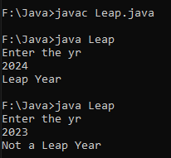
Conditional Statements
WAP to check if the user entered year is leap or not
import java.util.*;
class Leap {
public static void main(String[] args) {
int yr;
Scanner sc=new Scanner(System.in);
System.out.println("Enter the yr");
yr=sc.nextInt();
if((yr%4==0 && yr%100!=0)||(yr%100==0 && yr%400==0))
System.out.println("Leap Year");
else
System.out.println("Not a Leap Year");
} }

Slide 36
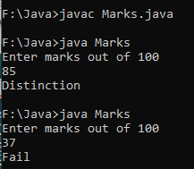
Conditional Statements
WAP to display the class according to the marks scored by student using switch case. The marks scored is taken input from the user and the class is displayed based on the range given below
import java.util.*;
class Marks {
public static void main(String[] args) {
int marks;
Scanner sc=new Scanner(System.in);
System.out.println("Enter marks out of 100");
marks=sc.nextInt();
if (marks==100)
System.out.println("Distinction");
switch(marks/10)
{
case 0:
case 1:
case 2:
case 3: System.out.println("Fail");
break;
case 4: System.out.println("Pass Class");
break;
case 5: System.out.println("Second Class");
break;
Marks | Class
70-100 | Distinction
60-69 | First
50-59 | Second
40-49 | Pass
0-39 | Fail
case 6: System.out.println("First Class");
break;
case 7:
case 8:
case 9: System.out.println("Distinction");
break;
default: System.out.println("InvalidMarks");
} } }

Slide 37
Iterative Statements
For loop
While loop
Do-while loop
import java.util.*;
class Natural{
public static void main(String args[])
{
int i, n;
Scanner sc=new Scanner (System.in);
System.out.println(“Enter n : “);
n=sc.nextInt();
for(i=1;i<=n;i++)
{
System.out.println(i);
}
}
}
import java.util.*;
class NaturalWhile{
public static void main(String args[])
{
int i, n;
Scanner sc=new Scanner (System.in);
System.out.println(“Enter n : “);
n=sc.nextInt();
i=1;
while(i<=n)
{
System.out.println(i);
i++;
}
}
}
import java.util.*;
class NaturalWhile{
public static void main(String args[])
{
int i, n;
Scanner sc=new Scanner (System.in);
System.out.println(“Enter n : “);
n=sc.nextInt();
i=1;
do
{
System.out.println(i);
i++;
}while(i<=n);
}
}

Slide 38
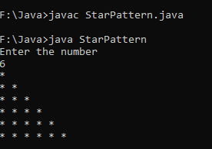

Iterative Statements
WAP to find factorial of a number
import java.util.*;
class Fact {
public static void main(String[] args) {
int n,i,fact=1;
Scanner sc=new Scanner(System.in);
System.out.println("Enter the number");
n=sc.nextInt();
for(i = 1; i <= n; i++)
{ fact = fact * i; }
System.out.println("Factorial of " + n + " is " + fact);
}
}
WAP to display the pattern
import java.util.*;
class StarPattern {
public static void main(String[] args) {
int n,i,j;
Scanner sc=new Scanner(System.in);
System.out.println("Enter the number");
n=sc.nextInt();
for(i=1;i<=n;i++)
{
for(j=1;j<=i;j++)
{
System.out.print("* ");
}
System.out.println();
} } }

Slide 39
Arrays (single dimensional)
an array is a collection of multiple data of same datatype
Indexing in an array starts from 0. The last index is n-1 where n is the size of the array.
Syntax for declaring array : datatype array_name[]=new datatype[array_size];
Eg : int arr[]=new int[10];

Slide 40
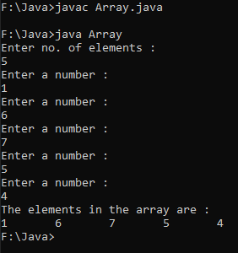
Arrays (single dimensional)
WAP to input and display n elements in an array
import java.util.*;
class Array{
public static void main(String args[])
{
int i,n;
Scanner sc=new Scanner(System.in);
System.out.println("Enter no. of elements : ");
n=sc.nextInt();
int a[]=new int[n];
for(i=0;i<=n-1;i++)
{
System.out.println("Enter a number : ");
a[i]=sc.nextInt();
}
System.out.println("The elements in the array are : ");
for(i=0;i<=n-1;i++)
{
System.out.print(a[i]+"\t");
} } }

Slide 41
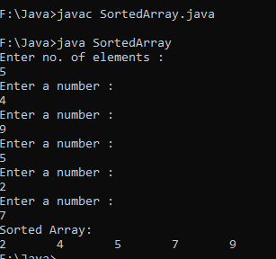
Arrays (single dimensional)
WAP to sort an array in ascending order
import java.util.*;
class SortedArray{
public static void main(String args[])
{
int i,n,temp;
Scanner sc=new Scanner(System.in);
System.out.println("Enter no. of elements : ");
n=sc.nextInt();
int a[]=new int[n];
for(i=0;i<=n-1;i++)
{
System.out.println("Enter a number : ");
a[i]=sc.nextInt();
}
for(i=0;i<=n-2;i++)
{
for(int j=0;j<=n-2;j++)
{
if(a[j]>a[j+1])
{
temp=a[j];
a[j]=a[j+1];
a[j+1]=temp;
}
}
}
System.out.println("Sorted Array: ");
for(i=0;i<=n-1;i++)
{
System.out.print(a[i]+"\t");
} } }

Slide 42
Arrays (multi dimensional)
The Java multidimensional arrays are arranged as an array of arrays i.e. each element of a multi-dimensional array is another array.
The representation of the elements is in rows and columns.
Thus, you can get a total number of elements in a multidimensional array by multiplying row size with column size.
So if you have a two-dimensional array of 3×4, then the total number of elements in this array = 3×4 = 12
The simplest of the multi-dimensional array is a two-dimensional array.
A simple definition of 2D arrays is: A 2D array is an array of one-dimensional arrays.
In Java, a two-dimensional array is stored in the form of rows and columns and is represented in the form of a matrix.
The general declaration of a two-dimensional array is,
data_type[][] array_name = new data_type[row_size][column_size];
Eg : int a[][]=new int[3][4];

Slide 43
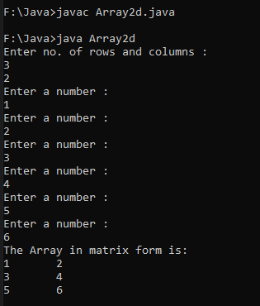
Arrays (multi dimensional)
import java.util.*;
class Array2d
{
public static void main(String[] args) {
int i,j,m,n;
Scanner sc=new Scanner(System.in);
System.out.println("Enter no. of rows and columns : ");
m=sc.nextInt();
n=sc.nextInt();
int a[][] = new int[m][n];
for (i=0;i<=m-1; i++) {
for (j=0;j<=n-1;j++) {
System.out.println("Enter a number : ");
a[i][j]=sc.nextInt();
} }
System.out.println("The Array in matrix form is:");
for (i=0;i<=m-1;i++) {
for (j=0;j<=n-1;j++) {
System.out.print(a[i][j]+"\t");
}
System.out.println();
} } }

Slide 44
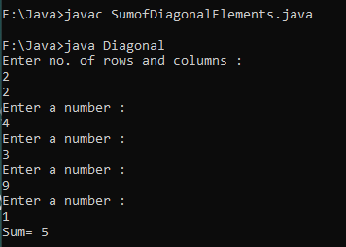
Arrays (multi dimensional)
WAP to find and display sum of the diagonal elements of a square matrix
import java.util.*;
class Diagonal
{
public static void main(String[] args) {
int i,j,m,n,sum=0;
Scanner sc=new Scanner(System.in);
System.out.println("Enter no. of rows and columns : ");
m=sc.nextInt();
n=sc.nextInt();
int a[][] = new int[m][n];
for (i=0;i<=m-1; i++) {
for (j=0;j<=n-1;j++) {
System.out.println("Enter a number : ");
a[i][j]=sc.nextInt();
} }
for (i=0;i<=m-1;i++) {
for (j=0;j<=n-1;j++) {
if(i==j)
sum=sum+a[i][j];
} }
System.out.println("Sum= "+sum);
} }

Slide 45
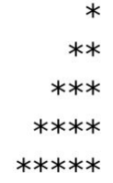
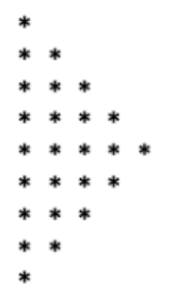
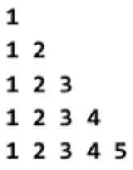
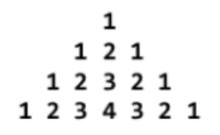
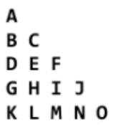
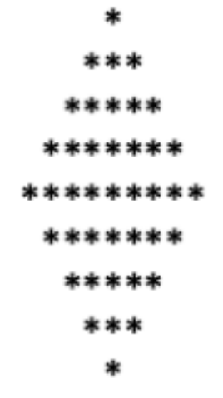
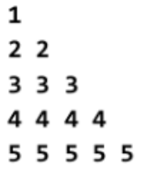
Programming Practice Questions
WAP to accept a number and display its equivalent ASCII character using type casting.
WAP to find largest of three numbers accepted from the user through command line using ternary operator.
WAP to display first n odd numbers
WAP to calculate and display sum of square of first n natural numbers.
WAP to display first n elements of Fibonacci series.
WAP to calculate value of following series – 1 + 1/2 + 1/3 + 1/4 +….+ 1/n
WAP to calculate value of following series – 1 + 1/2! + 1/3! + 1/4! +….+1/n!
WAP to calculate and display value of s for t=1,5,10,15,20,….,100. Formula : s = s₀ + v₀ + ½ a t²
WAP to display following patterns

Slide 46
Programming Practice Questions
WAP to count number of digits in a user entered number using while loop.
WAP to display a user entered number as a sequence of individual digits using while loop. Eg : 1691 should be displayed as 1 6 9 1
WAP to check if a user entered number is divisible by 3 and 5 or not.
WAP to check if the entered number is Armstrong number or not.
WAP to display the class according to the marks scored by student using if else if. The marks scored is taken input from the user and the class is displayed based on the range given below
WAP to display a user digit number in words using switch case. Eg : i/p : 123 o/p : One Two Three
WAP to find GCD and LCM of user entered two numbers.
WAP to find largest element from the array.
Marks | Class
70-100 | Distinction
60-69 | First
50-59 | Second
40-49 | Pass
0-39 | Fail

Slide 47
Programming Practice Questions
WAP to display average of n integers stored in an array
WAP to search an element in an array and if found display the index.
WAP to sort an array.
WAP to add two matrices of size m x n
WAP to find transpose of a matrix of size m x n
The annual examination results of 5 students are tabulated as follows
WAP to read the data and determine the following
Total marks obtained by each student
The highest total marks and the student who obtained highest total marks.
Roll No | Subject 1 | Subject 2 | Subject 3
1
2
3
4
5

